Slide 1


World’s Largest Independent
Mobile Ad Network
The Economics of Building an
Advertising Supported App Business
March 31, 2011

Slide 2
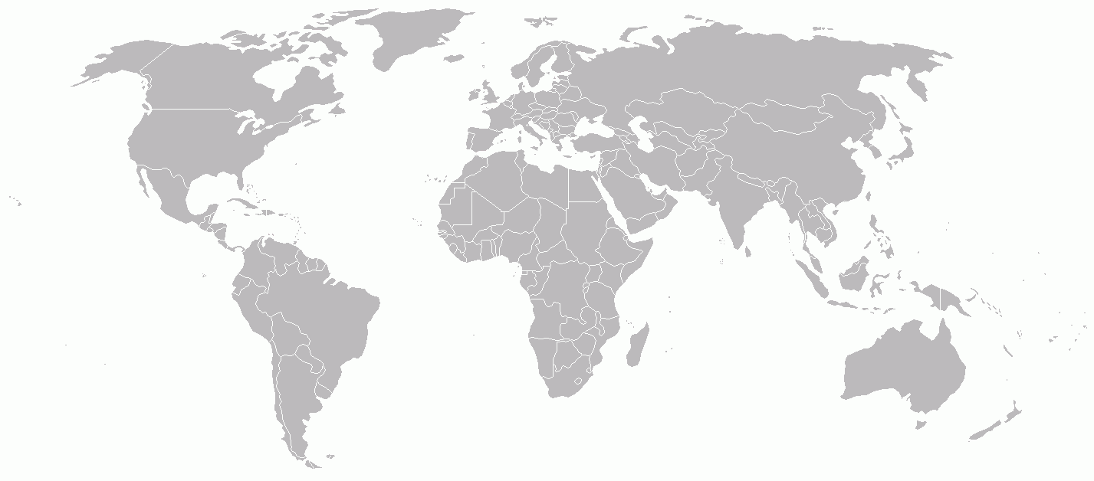
We’re a Mobile Ad Network
31.5 Billion impressions
6 Offices
Live in 115 countries
194 M Consumers reached
185 employees
Backed by KPCB & Sherpalo
London
San Francisco
Tokyo
Bangalore
Singapore
Johannesburg

Slide 3




From the eyes of a developer
Exciting Times
Highly competitive

Slide 4

The Opportunity
Huge opportunity for developers
Mobile eco-system is still emerging
Top apps are worth millions of dollars
Since its release over 60 million copies of the game Angry Birds have been downloaded.

Slide 5
Revenue Models: Overview
There are only four ways to make money
Paid Downloads
Sponsorship
Advertising
In App Purchase
Each has strengths and weaknesses
Some models are more appropriate than others

Slide 6
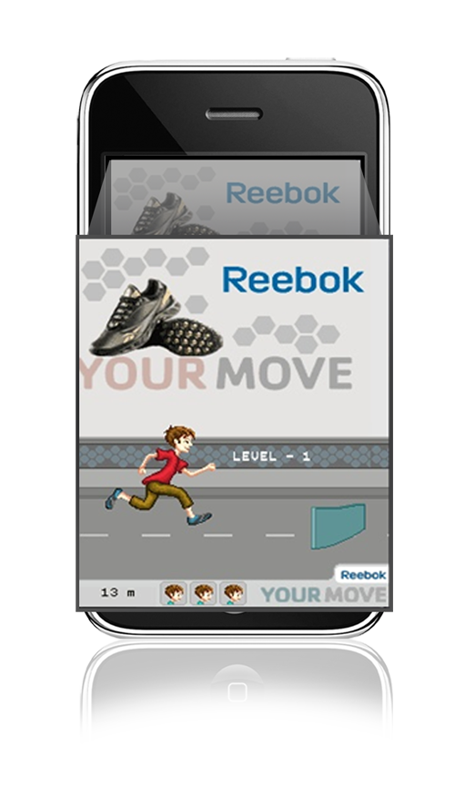

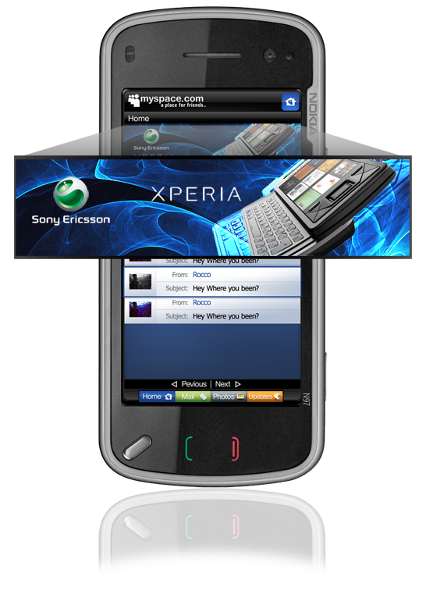
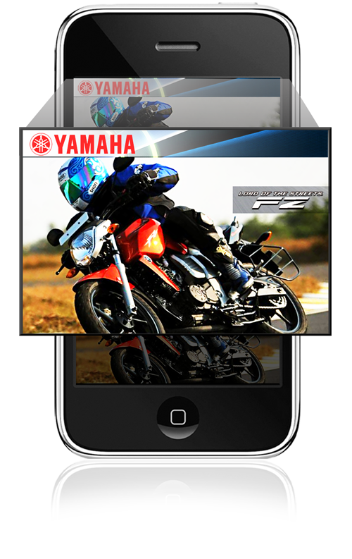
The Mobile Ad Opportunity
A $1 Billion market in the U.S. today
Globally it’s expected to exceed $20 B in 2013

Slide 7



Revenue Models: Advertising
Strength: Can drive more revenue than paid
Weakness: Requires large installed base
Photobucket
Moco Space
Examples
Shotgun

Slide 8
How to Pick a Network
Some important questions:
In what regions are you trying to monetize?
What platform are you developing for?
Type of content games, music, cars?
Is a third party platform right for you?
  Types of Network:
Blind
Network
Vertical
Network
Targeted
Network

Slide 9
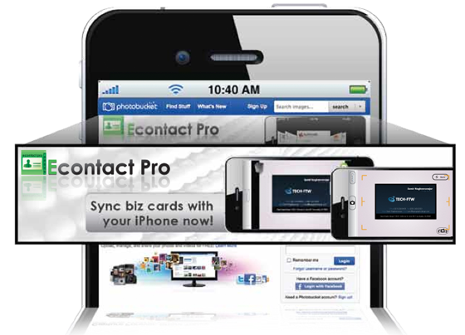
Tips and Tricks
Experiment with ad placement and format
Use data to improve performance
Use multiple ad networks
Create your own mediation layer
Develop directly for ad verticals (cars, travel, finance, etc.)
Test everything
Iterate often

Slide 10
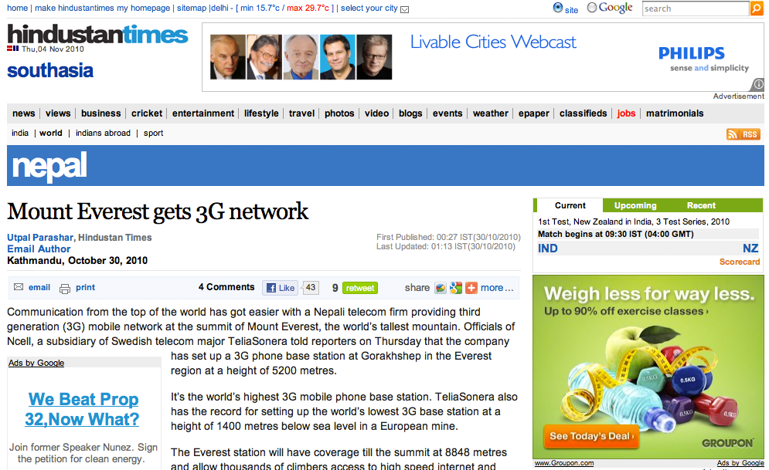
Think Globally

Slide 11
Think Globally
eCPMs vary globally but not by a big margin
129
125
  Index by region
  Sourced from our Network
101
90
70

Slide 12
eCPMs Top 20 Countries
Country | Index Range | Rank
Australia | > 150 | 1
Malaysia | > 150 | 2
Ireland | > 150 | 3
Thailand | > 150 | 4
South Africa | > 150 | 5
Russian Federation* | > 150 | 6
New Zealand* | > 150 | 7
United Kingdom | > 150 | 8
Italy | > 150 | 9
USA | > 150 | 10
Country | Index Range | Rank
UAE* | 120 to 149 | 11
Sweden | 120 to 149 | 12
Norway | 120 to 149 | 13
Germany | 120 to 149 | 14
Singapore | 120 to 149 | 15
Saudi Arabia* | 80 to 120 | 16
Brazil* | 80 to 120 | 17
France | 80 to 120 | 18
Spain | 80 to 120 | 19
Jordan* | 80 to 120 | 20

Slide 13

Froggy Jump Case Study
Invictus Games Sees eCPMs as High as $5.99 for iPhone Game With InMobi

Slide 14

Shotgun Free Case Study
Inedible’s Shotgun Free iPhone App Triples International eCPMs With InMobi

Slide 15
Key Messages
Think globally
Build a sustainable business
Test and experiment
Optimize based on data
Have fun!
Participate in World Developer Program to get high revenue share!
http://www.inmobi.com/developer/programs/
@inmobi
@ashwani

